Slide 1




Cloud Native Applications
Introduction
Notes:
I want to talk to you about cloud native applications, DevOps, microservices and the processes & platforms for bringing them to production

Slide 2
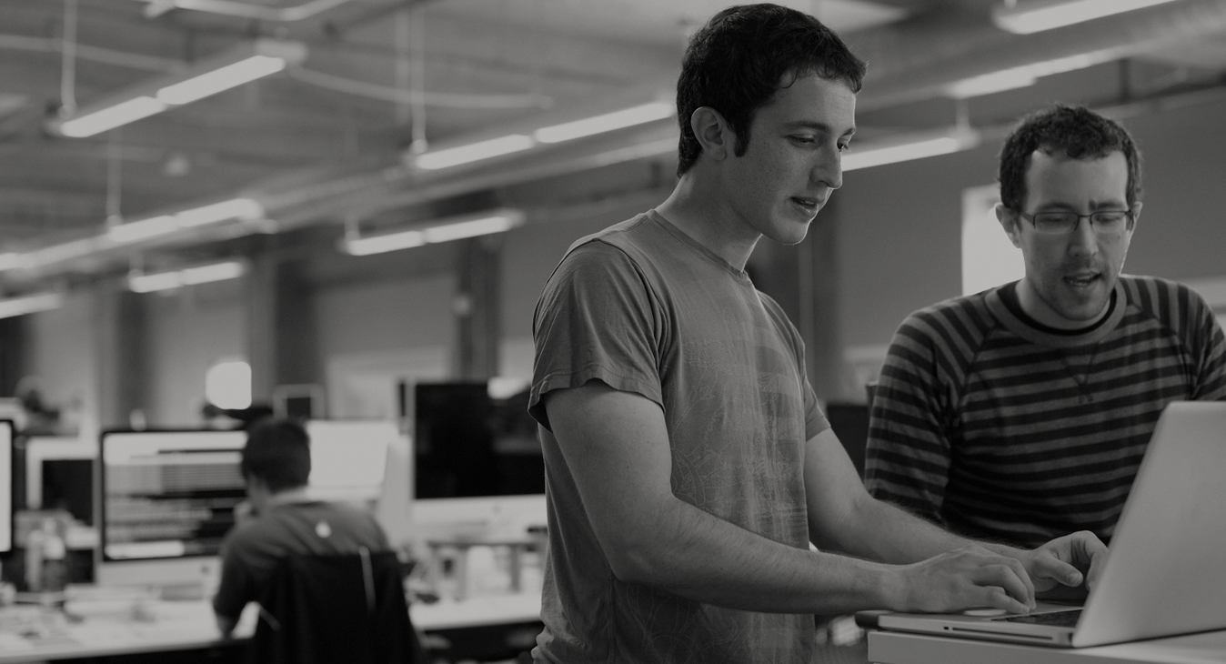

WE BELIEVE
Transforming how the world builds software will shape the future.
Notes:
At Pivotal, we believe Transforming how the world builds software will shape the future.
This is our core guiding principle that shapes our product and corporate strategy
But why change. Why talk about change.
Perfect storm

Slide 3
Agenda
Changing Development Models
Cloud Native Application Platforms
Pivotal Cloud Foundry
Notes:
I wanted to go over some of these emerging development models and
how tech companies have been successful in moving to these highly composable, resilient application architectures that we’re referring to as cloud native applications.
I want to show you what kind of platform tools the leading tech companies had to build.
And how these new designs are really hitting a lot of enterprises, companies that don’t depend on software directly.
We also want to showcase how these projects work together with a demo of a microservice-based Java app, built with Spring Boot and Netflix OSS projects
Before we turn it over to discussion

Slide 4
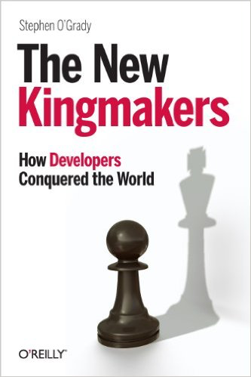
Notes:
Developers are the new kingmakers.
Software is changing (perfect storm)… yes it’s always changing but:
Mobile, always connected story (from starting w/ Call center agents)
Mobile First
Always connected
No downtime
Scale (huge number of users)
Updates (once a month)
3 key drivers
Software is free(ly available) - OSS
Compute is free
Information is free (Internet)
Results
Developers rule the world
Startups have no barrier to entry
*https://sensortower.com/blog/25-top-ios-apps-and-their-version-update-frequencies

Slide 5
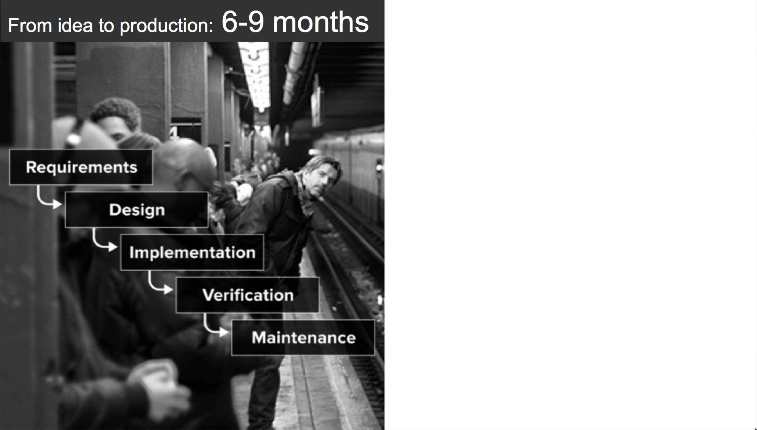
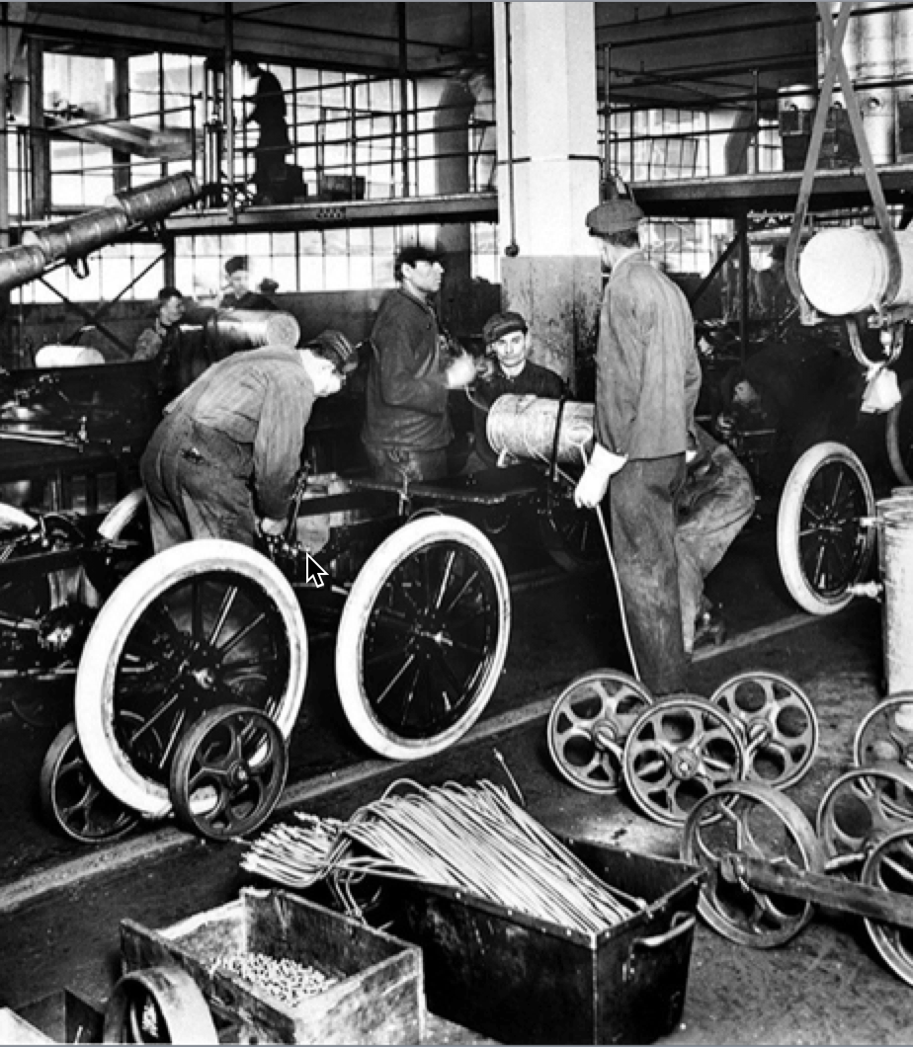
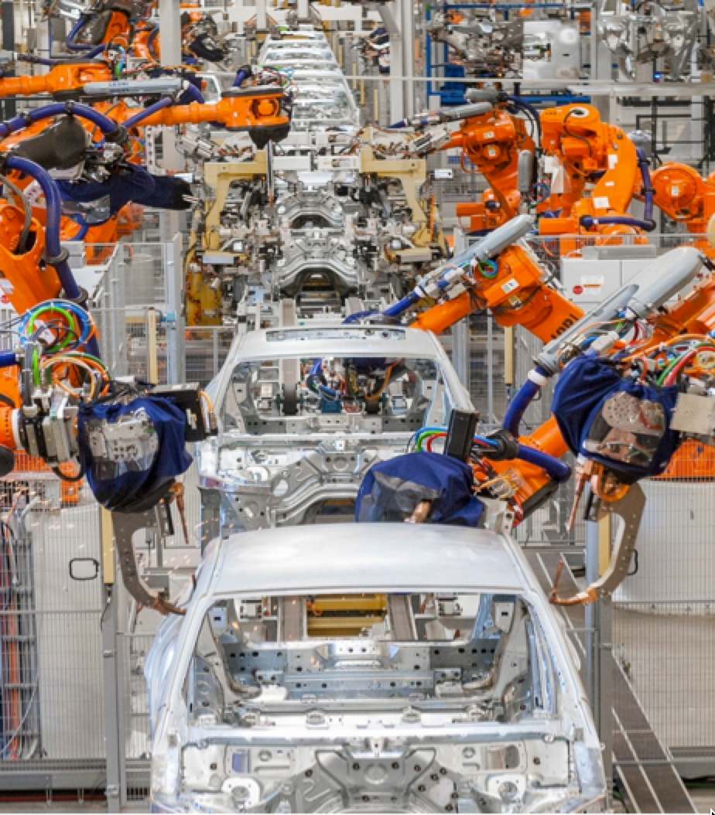

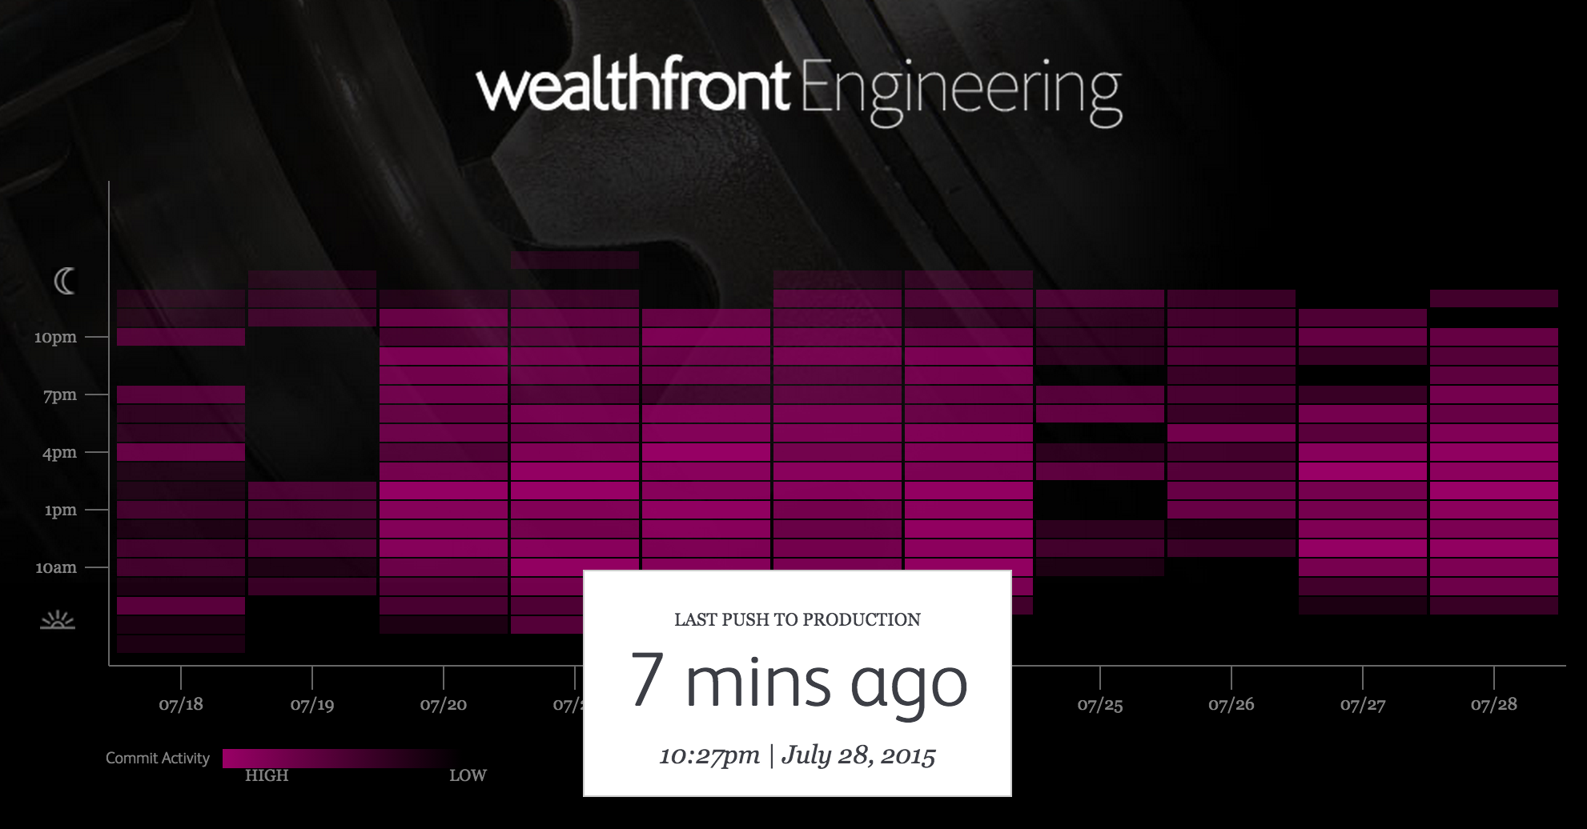

An idea in the morning, is running in production by evening
Then
Now
Notes:
Lets begin the conversation with contrasting the past with the present. Using the auto industry as a backdrop, we examine at how industrialization changed manufacturing for good.
Used to be: slow, manual, error prone, ridged.
We used to ship CDs… and this was a more appropriate way. Whats changed. People now walk around with a super computer in their pocket. Gone are they days of just a couple agents accessing your system...
Internet + Mobile
Freely Availabe Software
Free Compute
A&E – Corporate IT and Broadcast Engineering
Ford Assembly Line from back in the day. Today fully automated
Wealthfront engineering: known for having pivoted away from practice that were slowing them down, to embrace a new agile CI/CD deployment and delivery model that is fully automated. Changing release cycles to minutes instead of days or weeks.

Slide 6
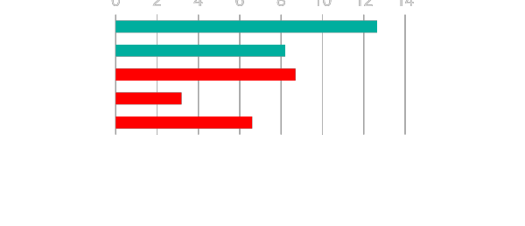
Software Developers Spend too Much Time NOT Writing Software
0 2 4 6 8 10 12 14
Design and Coding
Brainstorming
Administrative tasks
Managing Environments
Waiting for Test/Build
Average Hours/Week
17.5 hrs ~ 40% of full work week!
Sources: “Electric Cloud LinkedIn Survey to software developers”
Notes:
And here’s the reality.
You have a precious resource that’s spending TOO much of their time, not doing what you hired them to do. And for good reason.
How much then is the value of each developer’s key stroke to meeting innovation strategy targets? Protecting the developer’s ability to execute on innovation is key to realizing value from investment in top talent.

Slide 7
The developer dream haiku
Here is my source code,
Run it in the Cloud for me,
I do not care how
Notes:
In conclusion,
Cloud native is here - Its not iphone version 1, its not hipster software
We see massive adoption with large enterprise
Trends show –
DevOps
SpringBoot
Software
Talent shortage

Slide 8

The IT Operator reality
It's not enough just to deploy something
That's only Day One
You have to deploy again and again and again
Notes:
Getting software to production is just the first step. Running and maintaining it is far more.
Over 60% of the cost of software comes from maintaining and running it. http://www.irahul.com/2005/10/software-development-vs-software.html

Slide 9
IT Ops Spends Time Building Snowflakes
Request VMs
Request Network
Request Software Install
Request Database
Random Network Troubleshooting
DAYS
14
4
4
8
6
11
40
14
60
2
Nearly 6 months later
Random Middleware/OS Troubleshooting
Develop App
User Acceptance Testing
QA/Production Deploy Pipeline
Scale Up/Down
Notes:
As an example, here is a sample company that is bogged with too much legacy culture, process, and technology. In fact, this is quite generous. You know, it takes some companies three months to request a new VM, and once all is said and done, if they even have User/QA, the security teams have to do an internal review for vulnerability and compliance. Its no wonder that companies are falling behind! Sometimes I think all the process in place is just there to keep people employed, and a lot of this kind of thing has to do with company culture and legacy everything. Changing for the long run, only elevates everyone to levels of business which realizes the greatest value.

Slide 10






Software is changing INDUSTRIES
$6BN
Financial Services
$53BN
Entertainment
$26BN
Hotel
$34BN
Automotive
$50BN
Transportation
$3.2BN
Industrial Products
Notes:
Now, you might have seen some version of the story where several Silicon Valley companies are disrupting traditional industries and creating tremendous value.
Uber has no cars, AirBnB owns no real estate, Facebook doesn’t generate content and Amazon has no retail stores. This is all based on software. And that’s really a great story
To be honest, the only companies on this slide I have never used myself are a Tesla, and a Nest, however the ones I do use have saved me a lot of money. How can a business offer a better service, faster, and cheaper for themselves, and me? The key is agility.
--
The first law of disruption? Disruption is inevitable. However it is avoidable!

Slide 11
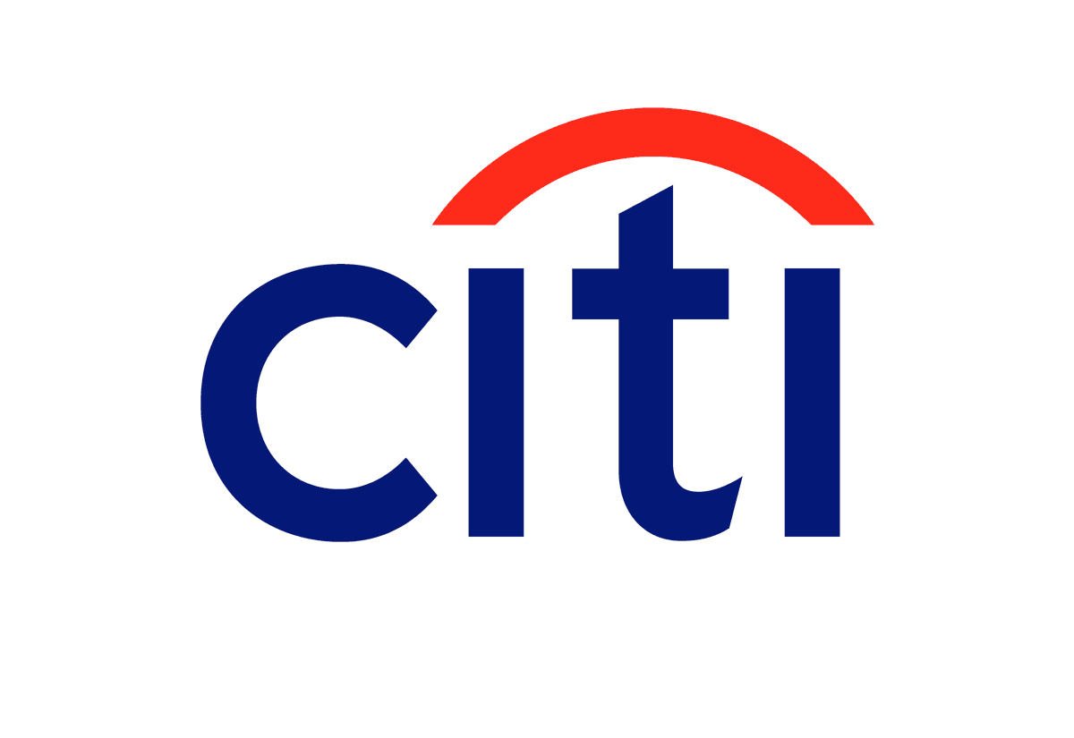

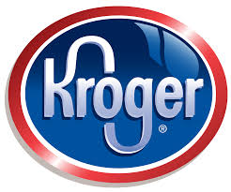
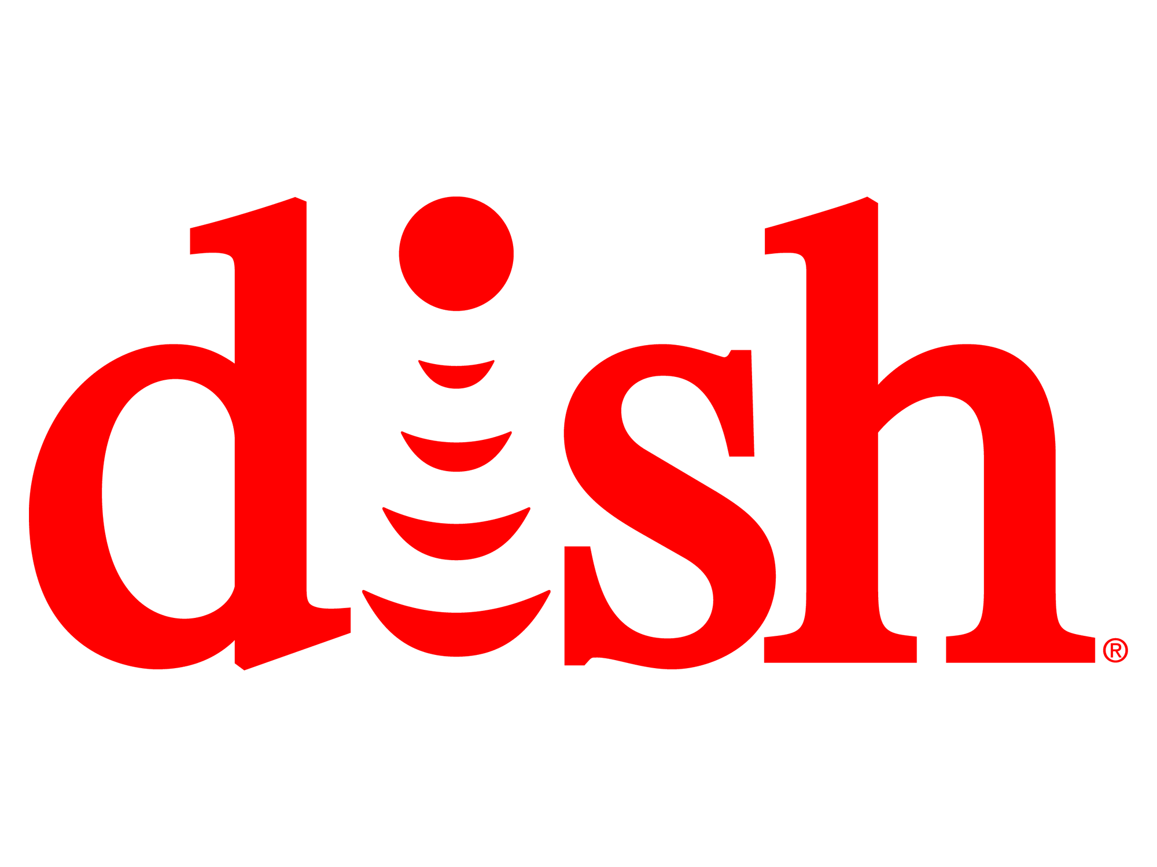

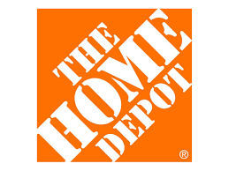
What about Enterprises
$132BN
Financial Services
$162BN
Entertainment
$31BN
Retail
$24BN
Broadcast Services
$50BN
Transportation
$171BN
Retail
Notes:
Now, you might have seen some version of the story where several Silicon Valley companies are disrupting traditional industries and creating tremendous value.
Uber has no cars, AirBnB owns no real estate, Facebook doesn’t generate content and Amazon has no retail stores. This is all based on software. And that’s really a great story
To be honest, the only companies on this slide I have never used myself are a Tesla, and a Nest, however the ones I do use have saved me alot of money. How can a business offer a better service, faster, and cheaper for themselves, and me? The key is agility.
--
The first law of disruption? Disruption is inevitable. However it is avoidable!

Slide 12
The Cloud Native Enterprise is here
Legacy Applications
Consumer Banking Application Portfolio
Core Billing and Activation Systems
5100+ applications
Store Locator Services
Mobile Applications
Field Technicians
Order Management
Offer Management
Labs and PCF
FordPass
Vehicle Configurator
Labs and PCF
Tool Rental Services
Contractor Lifecycle Management
Notes:
Now, you might have seen some version of the story where several Silicon Valley companies are disrupting traditional industries and creating tremendous value.
Uber has no cars, AirBnB owns no real estate, Facebook doesn’t generate content and Amazon has no retail stores. This is all based on software. And that’s really a great story
To be honest, the only companies on this slide I have never used myself are a Tesla, and a Nest, however the ones I do use have saved me alot of money. How can a business offer a better service, faster, and cheaper for themselves, and me? The key is agility.
--
The first law of disruption? Disruption is inevitable. However it is avoidable!

Slide 13

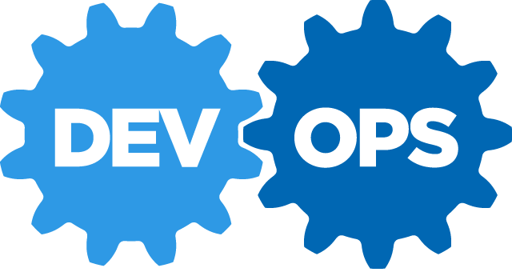
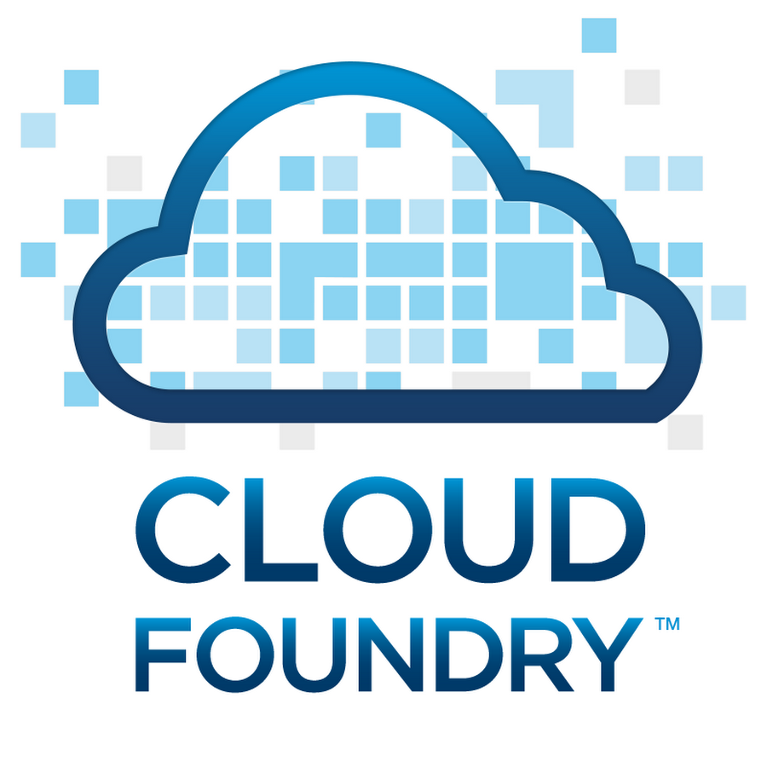




Software is CHANGING
Continuous Delivery
Spring Boot
Notes:
Software is changing industries but software itself is changing. You hear a lot about buzz-words and new technologies coming to play with ideas such as Microservices, DevOps, Continuous Delivery and of Containerization of workloads made popular by Docker.
Being a modern developer is challenging because it requires constantly updating ones knowledge and skills, but its also so exciting, because never before have we been able to get into the flow with less technical roadblocks.
By the end of today, youll be fluent in all these technologies.

Slide 14

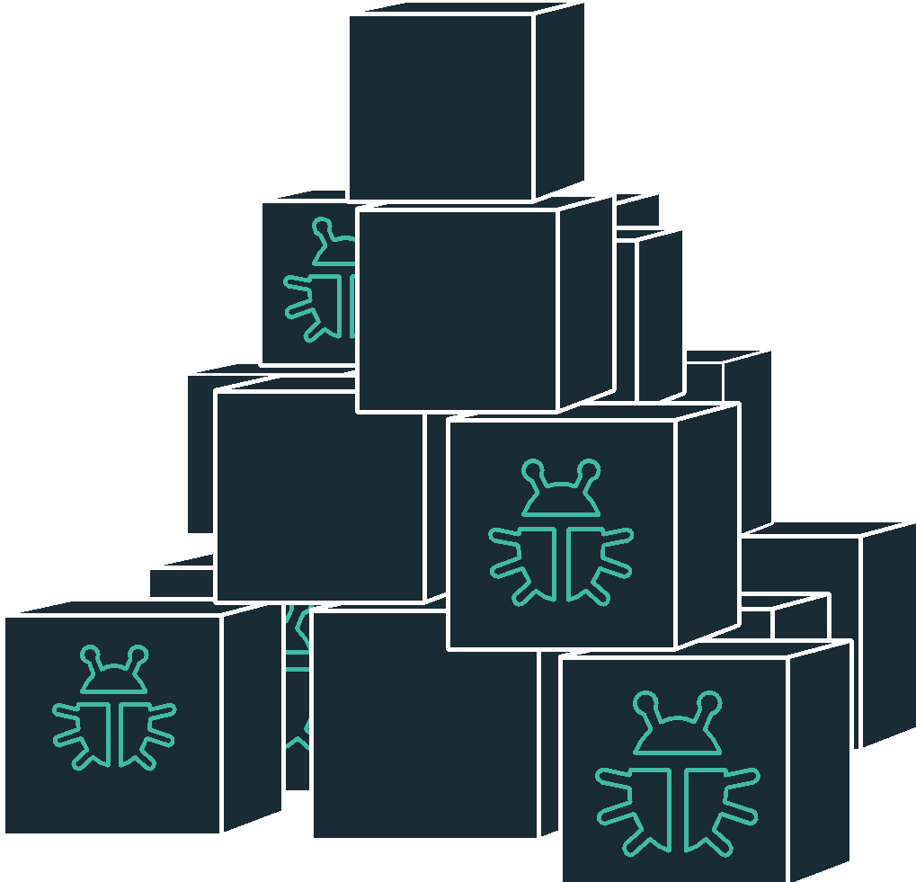

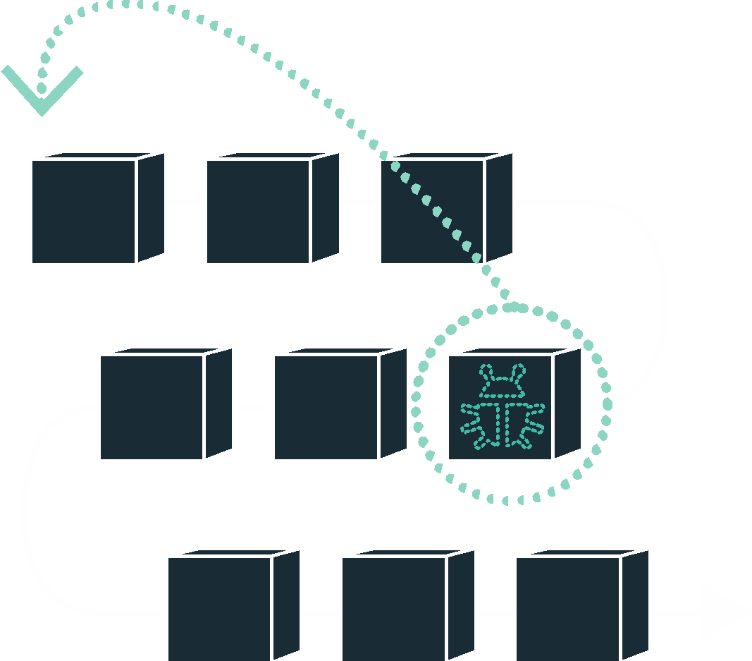


DevOps
Continuous Delivery
Microservices
Not my problem
Separate tools, varied incentives, opaque process
Release once every 6 months
More Bugs in production
Tightly coupled components
Slow deployment cycles waiting on integrated tests teams
C L O U D N A T I V E
Shared responsibility
Common incentives, tools, process and culture
Release early and often
Higher Quality of Code
Loosely coupled components
Automated deploy without waiting on individual components
Notes:
Why Comcast is trying to adapt to is a new world

Slide 15
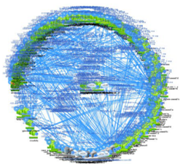
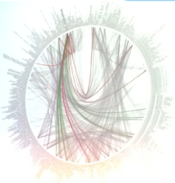


But… microservices are hard
Discovery
User Management
Failover and HA
Configuration
Security
API Management
Monitoring & Logging

Slide 16

Cloud Native Reference Architecture - Lots of moving parts
DATABASES AND DATA MANAGEMENT
VERSION CONTROL
CI / CD
SECURITY & COMPLIANCE
METRICS & DASHBOARDS
DEVELOPMENT FRAMEWORKS
API MANAGEMENT
DATA MICROSERVICES
LANGUAGES
DISCOVERY & REGISTRATION
CIRCUIT BREAKERS
LOAD BALANCING
Where should your best developers focus to maximise BUSINESS VALUE?
What does it take to deploy and operate ALL this at SCALE
MONITORING & LOGGING
CONTAINERS
MESSAGING
CONTAINER
ORCHESTRATION
NETWORKING
CLOUD ORCHESTRATION
& AUTOMATION
PRIVATE CLOUD
PUBLIC CLOUD
Notes:
ANY language
ANY middleware
ANY cloud
ANY

Slide 17
Cloud Native Reference Architecture (Ecosystem)
DATABASES AND DATA MANAGEMENT
Traditional RDBMS
Oracle MySQL
SQL Server
NoSQL datastores
MongoDB Cassandra
Couchbase
Cache and IMDG
Gemfire Coherence
VERSION CONTROL
Github
Gitlab
SVN
CI / CD
Jenkins
Concourse
Artifactory
SECURITY & COMPLIANCE
OAuth
UAA
LDAP
Kerberos
SSL/TLS
PCI
HIPAA/HL7
METRICS & DASHBOARDS
Collection
Storage
Dashboards
Alerts
Spinnaker
DEVELOPMENT FRAMEWORKS
Spring / SCS
Entity Framework
Micro
API MANAGEMENT
APIgee
Mashery
DIY
DATA MICROSERVICES
Spring Cloud DataFlow
Storm
Fink/NiFi
LANGUAGES
Java
.NET
Python
DISCOVERY & REGISTRATION
Consul
Eureka
etcd
CIRCUIT BREAKERS
Hystrix
DIY
LOAD BALANCING
Ribbon
Zuul (client side)
Ruby
Go
*.JS
Zookeeper
Where should your best developers focus to maximise BUSINESS VALUE?
What does it take to deploy and operate ALL this at SCALE
MONITORING & LOGGING
Log Aggregation
Storage
Thresholds
Metering
CONTAINERS
MESSAGING
Garden Docker runC
Kafka RabbitMQ
CONTAINER
ORCHESTRATION
Cloud Foundry Runtime Kubernetes Swarm Marathon ECS
NETWORKING
DNS
Load Balancing
Intelligent Routing
Network Segmentation
Firewalls
CLOUD ORCHESTRATION
& AUTOMATION
BOSH / Cloud Foundry Chef Puppet Ansible SaltStack Mesos
PRIVATE CLOUD
PUBLIC CLOUD
vSphere OpenStack
AWS Azure GCP

Slide 18
Evolution of Platforms
Business Value, Agility & Cost Savings
Traditional IT
Virtualization
Platform
You Manage
Applications
Applications
Applications
Data
Data
Data
You Manage
Runtime
Runtime
Runtime
Middleware
Middleware
Middleware
You Manage
O/S
O/S
O/S
Virtualization
Virtualization
Virtualization
Servers
Servers
IaaS
Servers
Storage
Storage
Storage
Networking
Networking
Networking
Notes:
Value Line Whiteboard

Slide 19


D E M O
Notes:
Scale Demo – its the fastest to stage
Do not go too deep into all the features if PCF.
Session 2 will cover Org, Space, buildpacks, Containers, Scaling, etc
If this needs to be a full demo because stakeholders in the room, make sure not to talk too much to leave little time for the Labs, OK to deferr questions to the next Session on Arch and if the student is going to be in the lab for the rest of the workshop.

Slide 20
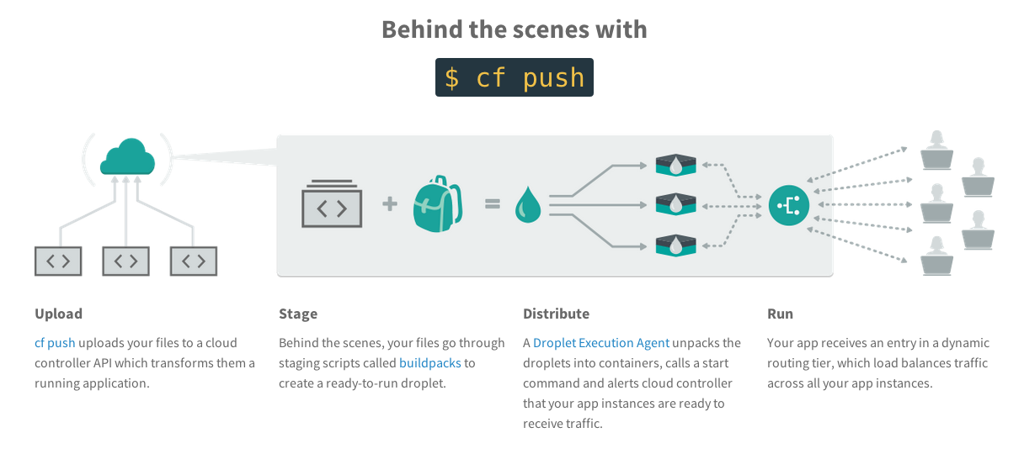
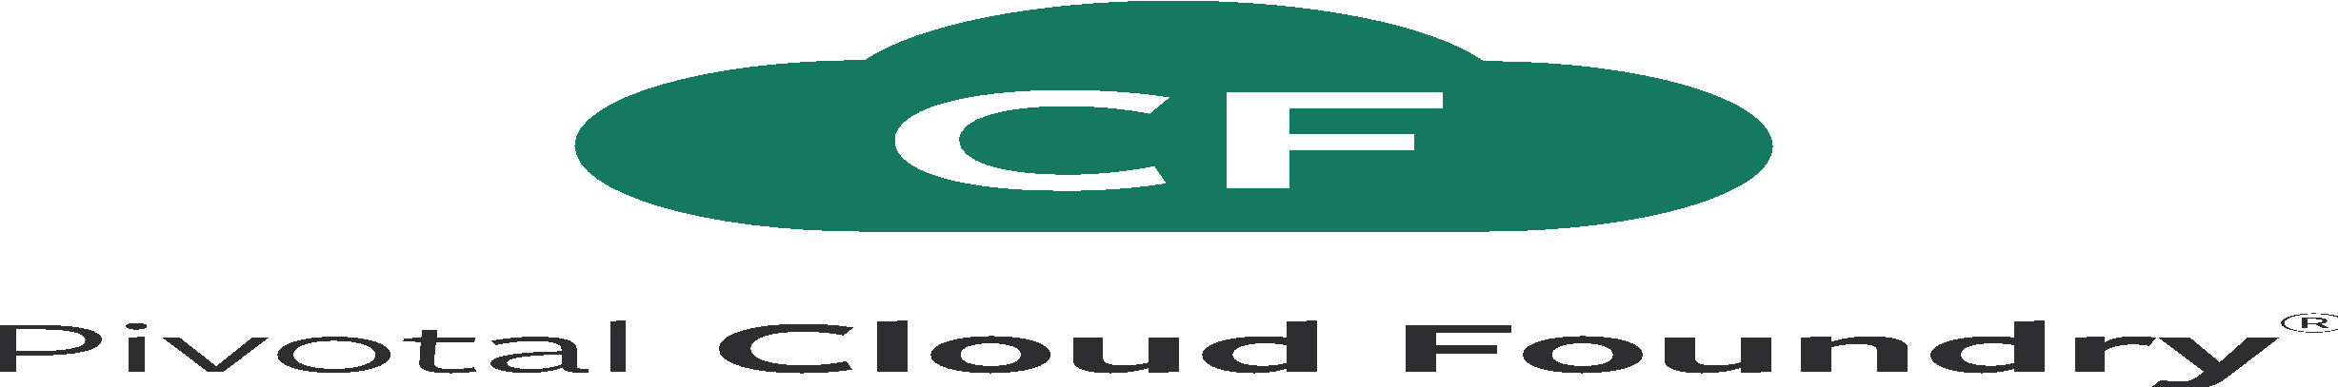
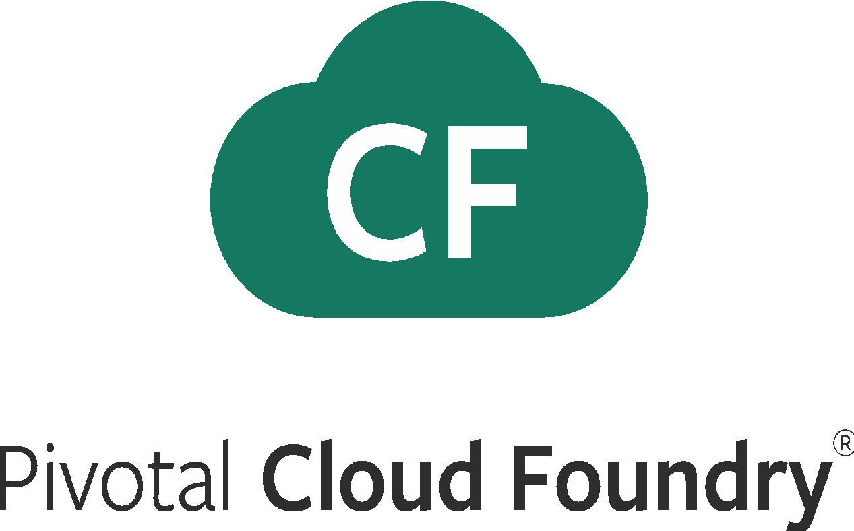
What Just Happened?
Notes:
Upload the bits
Stage: make a droplet
Distribute: execute in containers
Run: become routable

Slide 21
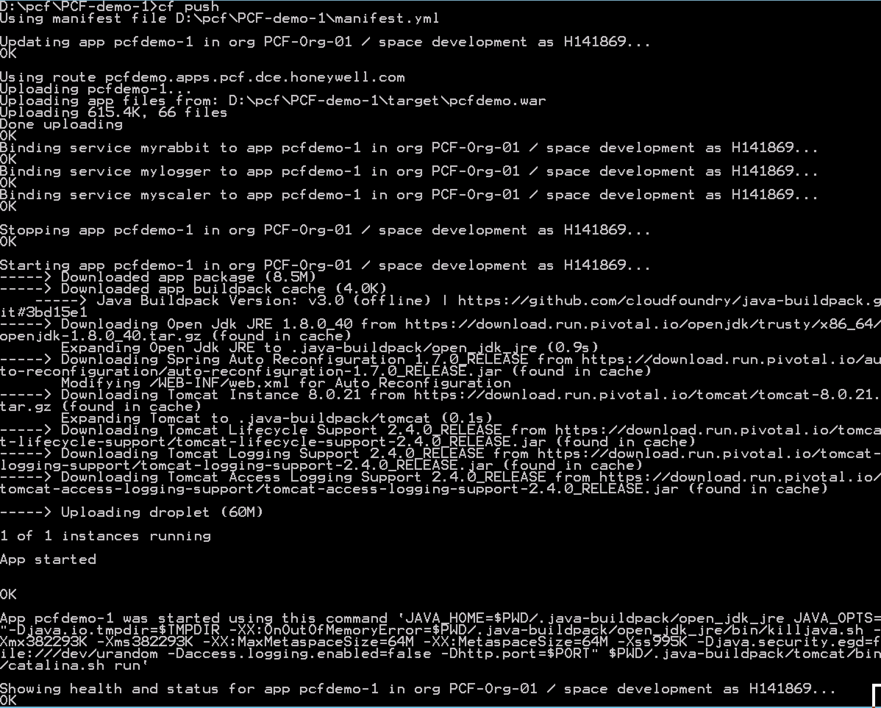
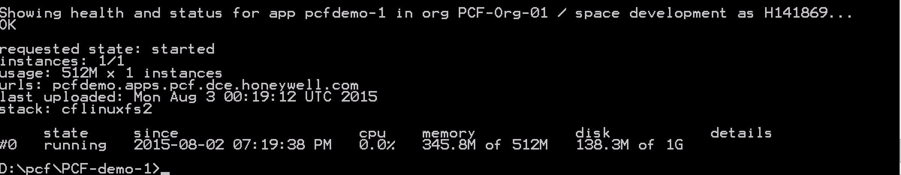
Full Stack Ticket Elimination
Firewall & Routes
Service Bindings
App Lifecycle
Runtime Installation & Config
Middleware Installation & Config
Application Installation & Config
App Lifecycle
Logging, Health, Telemetry

Slide 22

Open Source has won
Notes:
(bold moves)
2015 – This is..
The year where we see a level of adoption of our products and services that propels us to becoming an ipo-worthy company
This is..the year where our great vision becomes a reality in production environments at the most important companies and organizations in the world.
This is the year that we show and teach our customers and partners the power and opportunity that building great software brings.

Slide 23


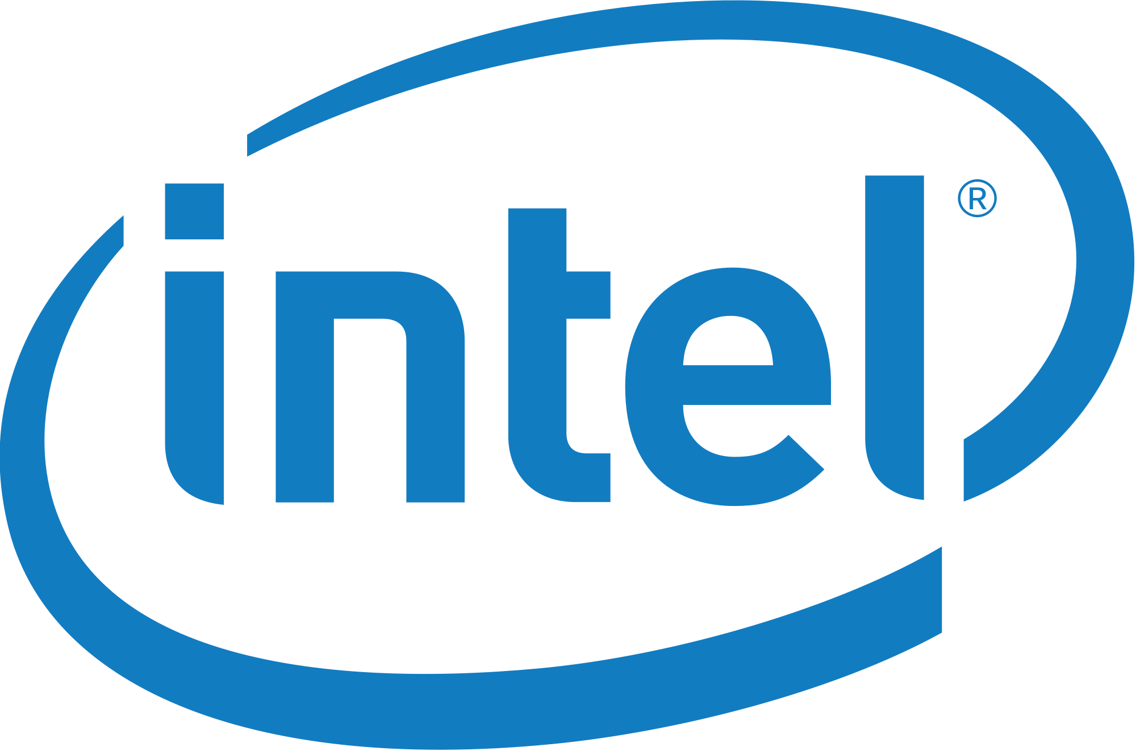
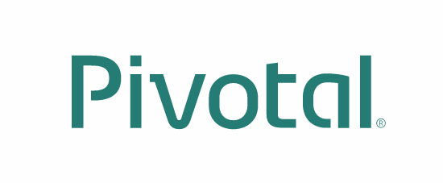
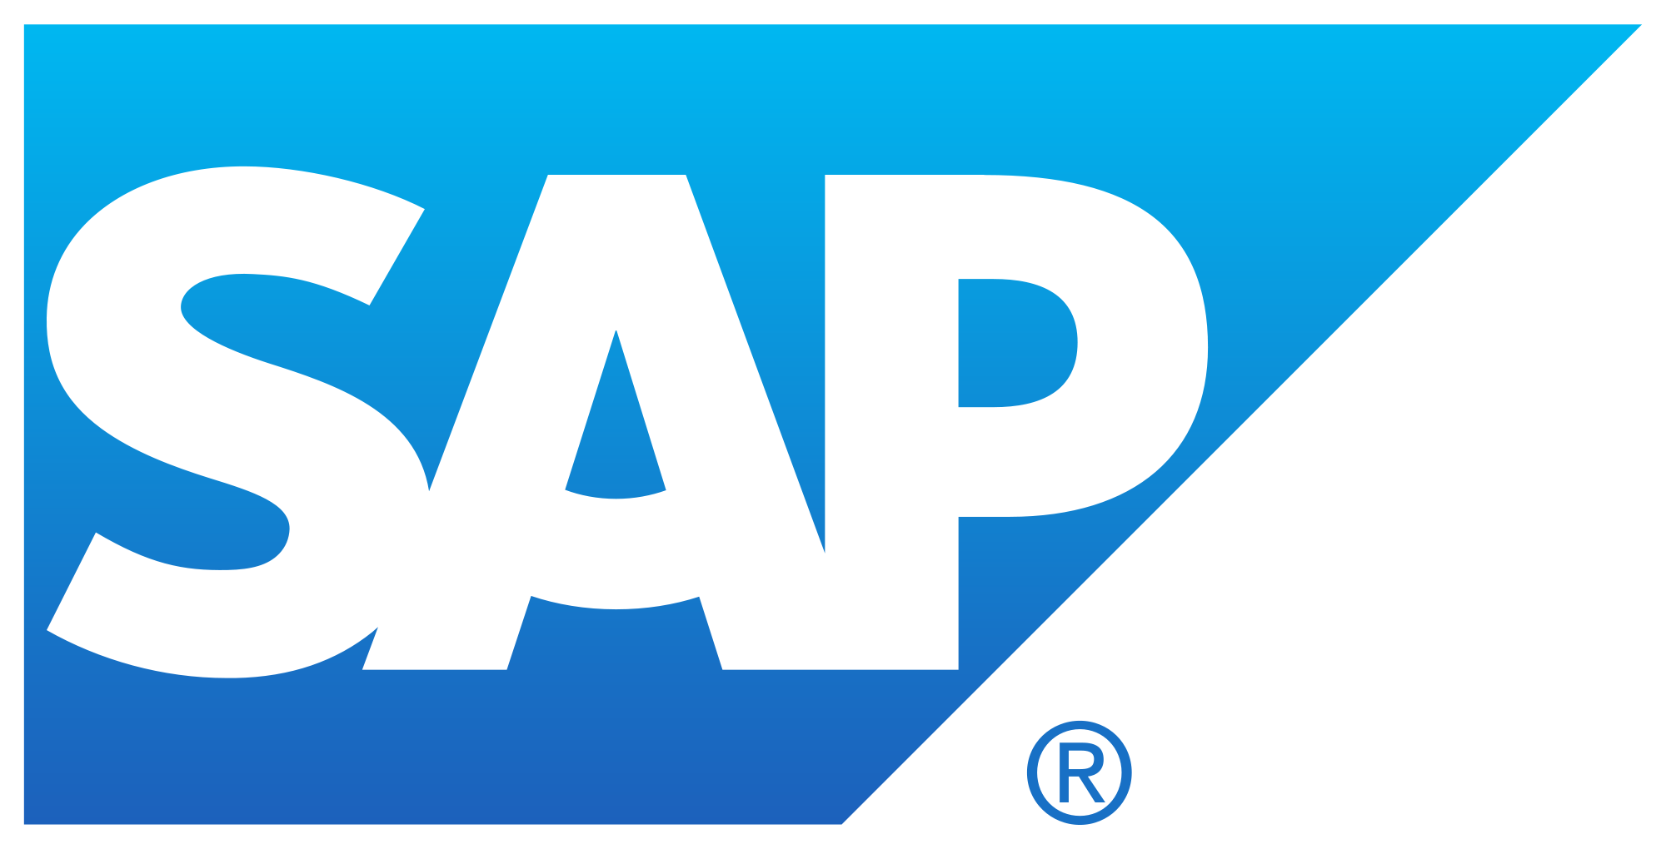




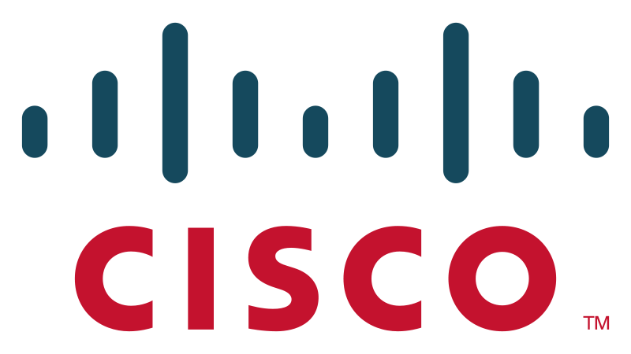











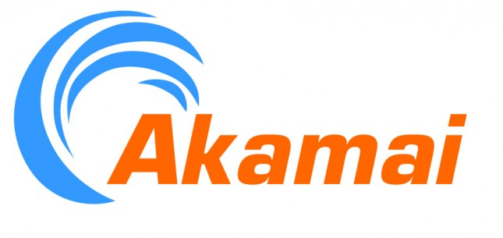







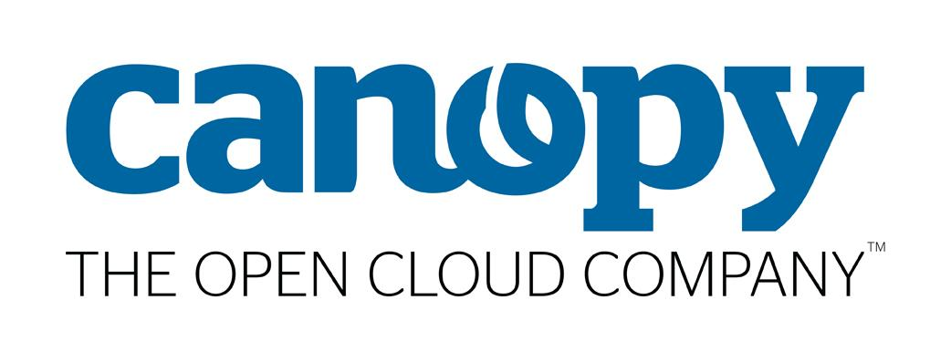
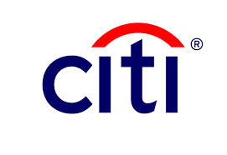
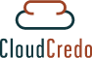


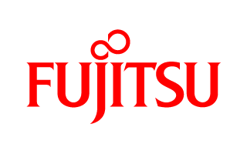







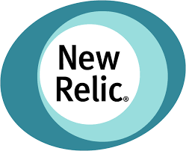



Pivotal Cloud Foundry
An Open Industry Standard
PLATINUM
GOLD
SILVER
Notes:
Open source software offers true community-driven outcomes. Cloud Foundry Foundation has 40+ companies that participate in the community with a vested interest in a platform that continues to grow and meet customer needs, now and in the future.

Slide 24
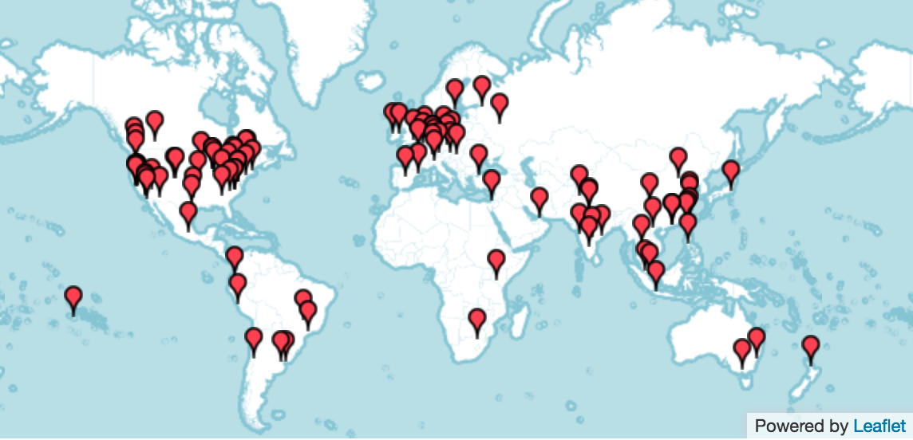
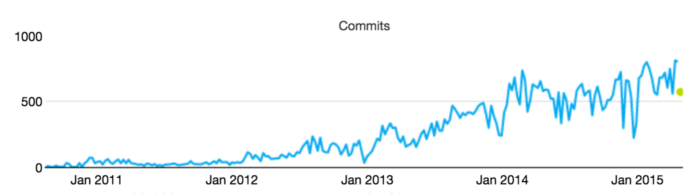
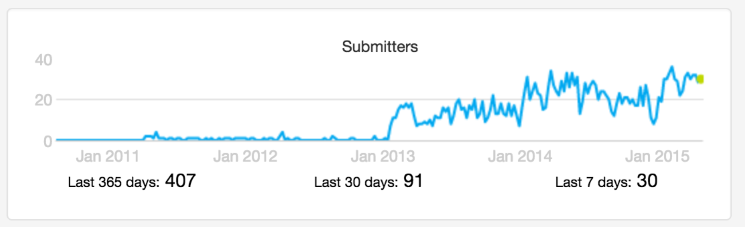
CF Open Source Momentum
Commits
Submitters
53 corporations are contributing members
158 meetups in 49 countries
21K members with ~5K joining last month
~2200 developers, ~650 Code Submitters, ~400 of them in last year
65K commits with ~30K of those in the last year
Source: http://cloud-foundry.meetup.com/ on Jun 12 2015

Slide 25
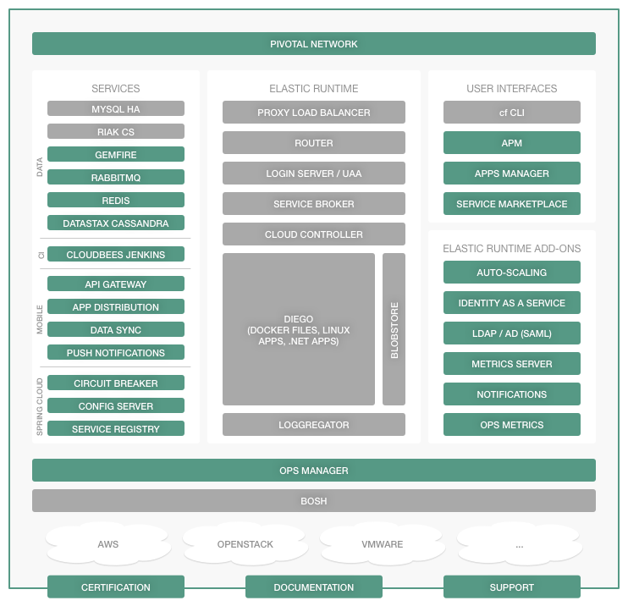
Pivotal Cloud Foundry Commercialization Model
Open source software provides the basis for the platform
Commercial distribution provides value add features, enterprise services, support, docs, certs etc.
Notes:
Our company may be young, but the codebase has developed over many years. Many of the original developers are still at Pivotal.
Cloud Foundry Open source software provides the foundation for the Pivotal Cloud Foundry platform. Commercial distribution provides enterprise services, support, docs, certs etc.
For more differences between Opensource and PCF: https://sites.google.com/a/pivotal.io/inside-pivotal-competitive-intelligence-page/oss

Slide 26
B R E A K
Notes:
(bold moves)
2015 – This is..
The year where we see a level of adoption of our products and services that propels us to becoming an ipo-worthy company
This is..the year where our great vision becomes a reality in production environments at the most important companies and organizations in the world.
This is the year that we show and teach our customers and partners the power and opportunity that building great software brings.

